Slide 1
Problem Statement and Understanding
With the covid 19 impact in the market, we have seen lot of changes in the car market. Now some cars are in demand hence making them costly and some are not in demand hence cheaper. One of our clients works with small traders, who sell used cars. With the change in market due to covid 19 impact, our client is facing problems with their previous car price valuation machine learning models. So, they are looking for new machine learning models from new data. We have to make car price valuation model.
There are lot of changes in the automobile market due to COVID 19. Because of this small car traders are suffering the most, hence we are building a car price prediction model to predict the price of used cars. This model will help the car traders to make better decision and decide their car’s price.

Slide 2
EDA Steps
Identifying sources of the data
Data collection
Data structuring
Analyzing the data
Cleaning and processing the data
Selecting most important features
Writing down findings and observations
Using different models to train the data
Selecting best fitted model for predictions
Predicting outcome for test data

Slide 3
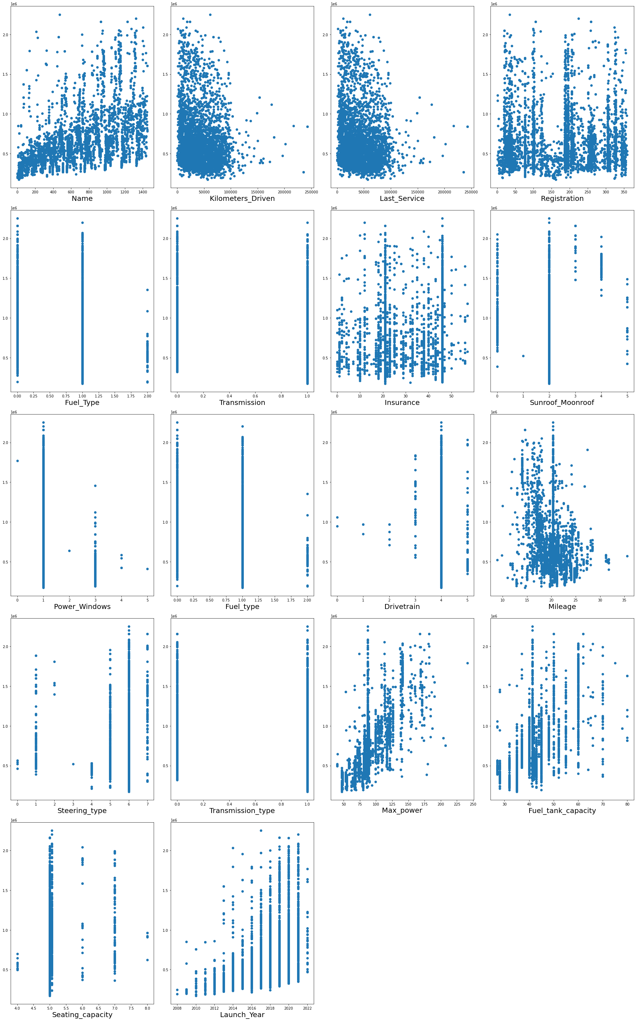
Visualizations
Scatter Plot: -
Observations:
• Name, Fuel_Type, Transmission, Power_Windows, Mileage, Max_power, Fuel_tank_capacity and Launch_Year has high co-relation with Label.
• Registration, Insurance, Sunroof_Moonroof and Steering_type columns has Low/No co-relation with Label.

Slide 4
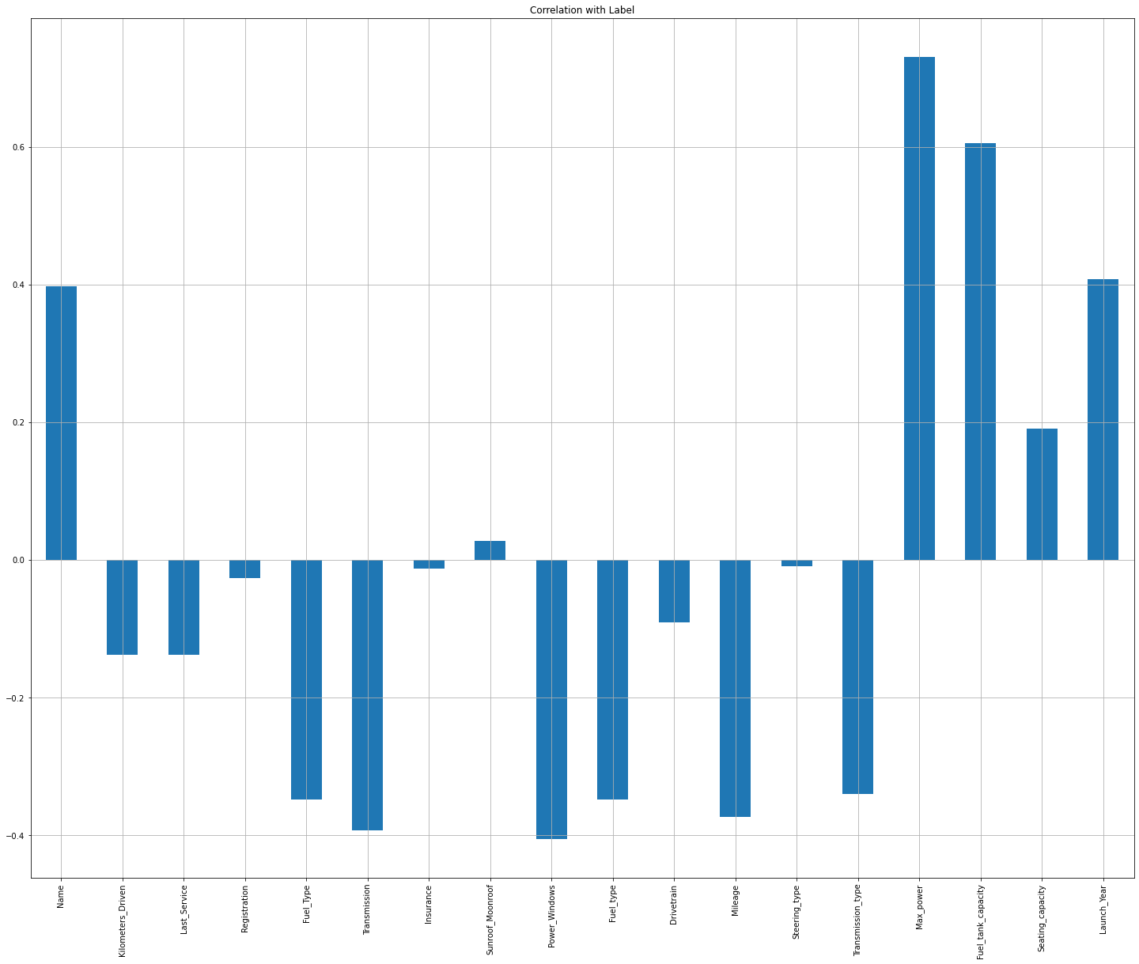
Visualizations
2. BarPlot: -
Observations:
• Name, Fuel_Type, Transmission, Power_Windows, Mileage, Max_power, Fuel_tank_capacity and Launch_Year has high co-relation with Label.
• Registration, Insurance, Sunroof_Moonroof and Steering_type columns has Low/No co-relation with Label.

Slide 5
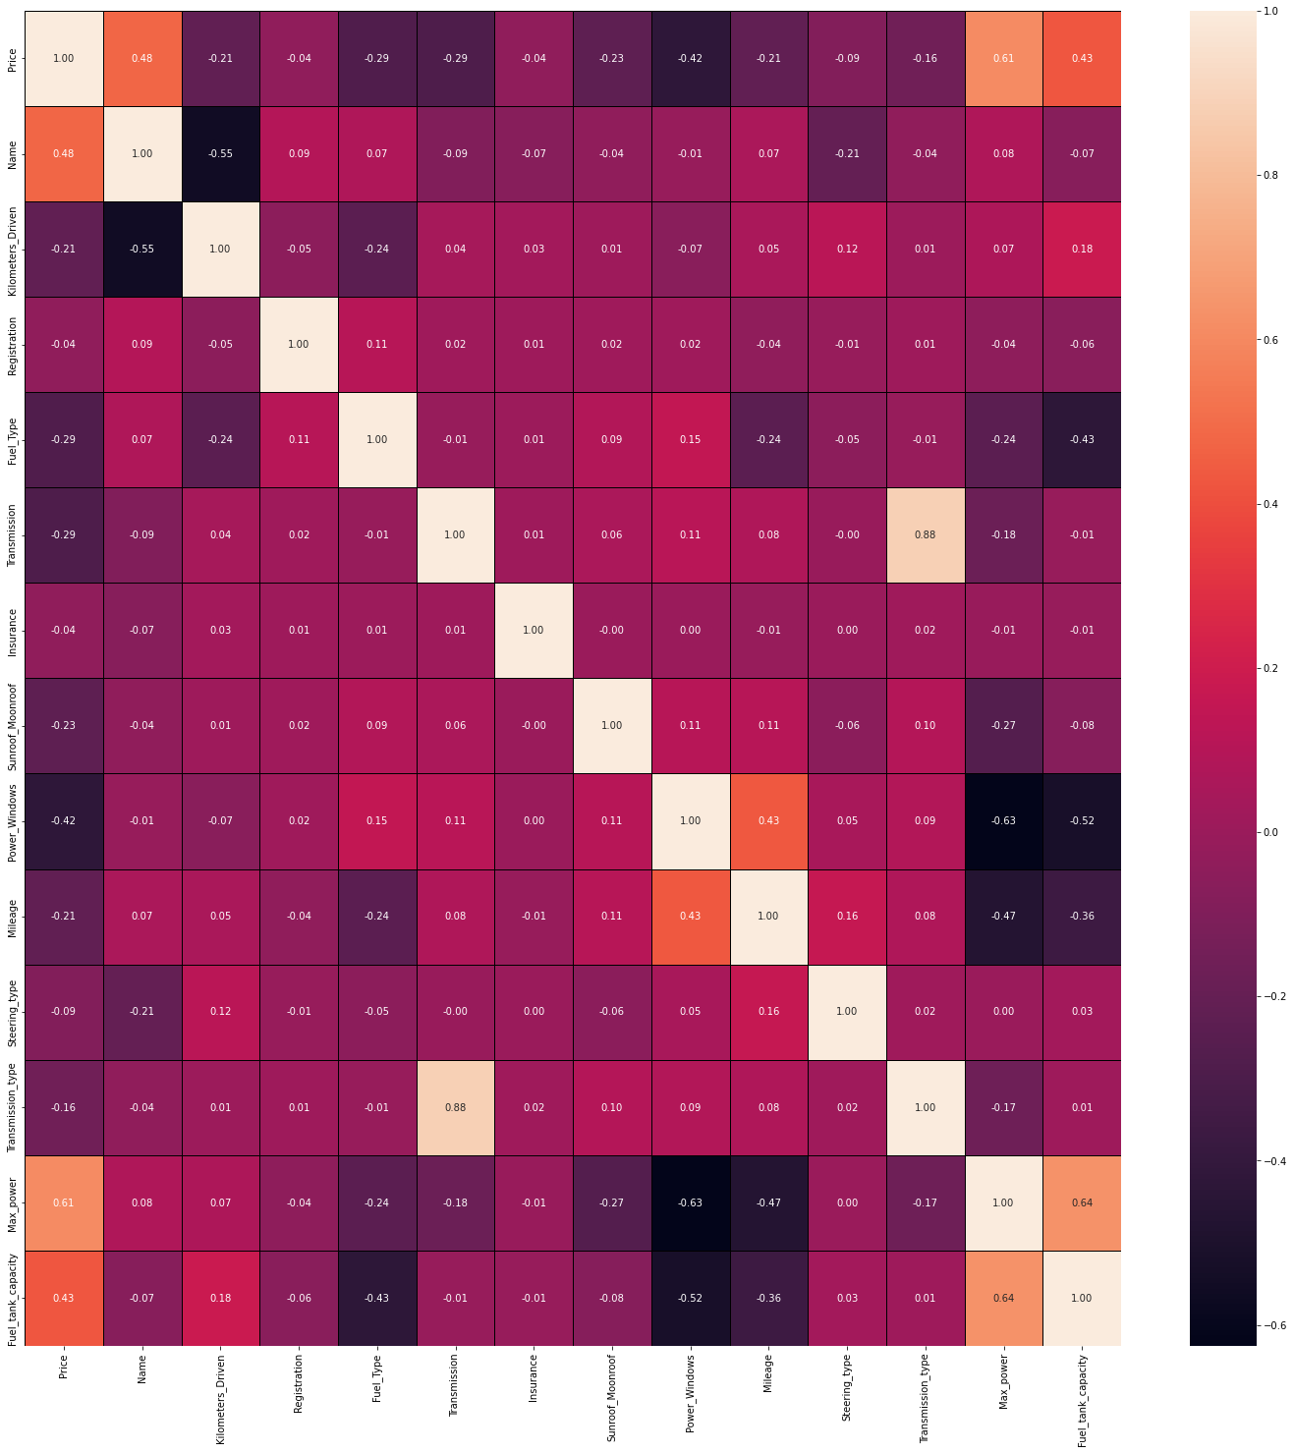
Visualizations
3. HeatMap: -
Observations:
• Transmission_type and Transmission has Multicollinearity problem.

Slide 6
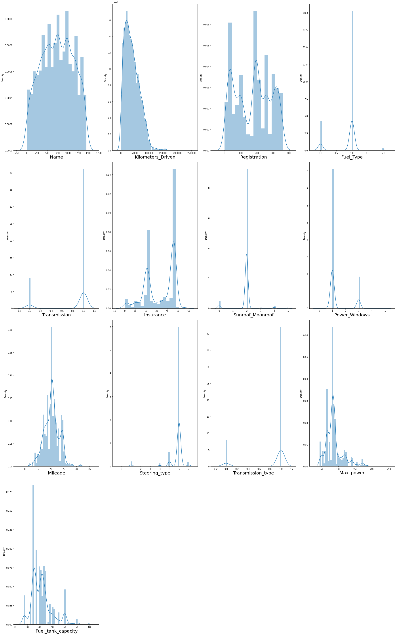
Visualizations
4. Distribution Plot: -
Observations:
• Not considering skewness of categorical data columns.
• Kilometers_Driven, Max_power and Fuel_tank_capacity has skewness.

Slide 7
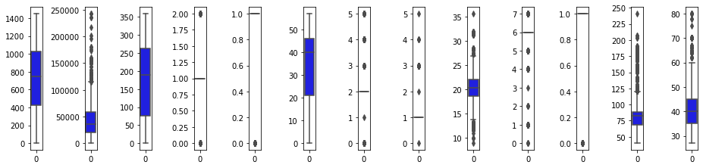
Visualizations
5. Box Plot: -
Observations:
• Kilometers_Driven, Mileage, Max_power and Fuel_tank_capacity Column has outliers.

Slide 8
Steps and Assumptions
Clean and organized the data.
Checked the data type of each column.
Changed the Object data type to Integer.
Checked whether the data has any Null Values and fill those Null values using Mean and Mode method.
Checked whether the data is categorical data or continuous data.
There are many categorical columns which has same output with different variable so standardized the data.
E.g: - In ‘Central_Locking’ column
'remote':'Remote'
'yes':'Yes'
'YES':'Yes’
Encoded remaining Object data type columns to integer using encoder technique.
Checked the co-relation of features with label i.e Price.
Checked the Multicollinearity between features.
Checked the VIF score of features.
Checked the Distribution of data.
Identified and removed outliers those are not allowed above and below the specific limit.

Slide 9
Model Dashboard
Identification of possible problem
The data was not structured and organized hence cleaned the data using various data cleaning and pre-processing techniques.
There are many outliers present in the data hence removed outliers
There was a skewness in the data hence have removed the skewness from the data.
Scaled the data using Standard Scalar to make the data standardized to build a model.
Testing of Identified Approaches
These are the algorithms which have been used to train and test data.
LinearRegression
DecisionTreeRegressor
AdaBoostRegressor
GradientBoostingRegressor
RandomForestRegressor
KNeighborsRegressor
Support Vector Regression

Slide 10
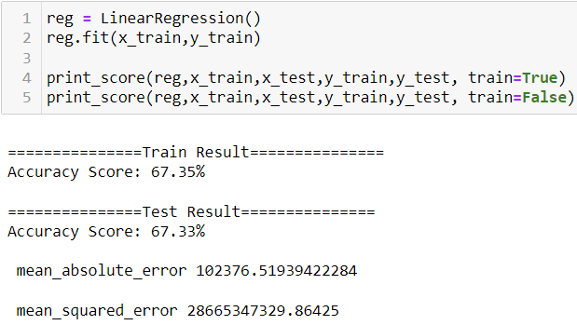
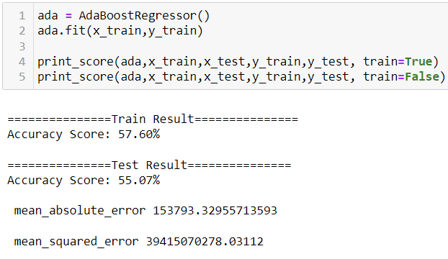
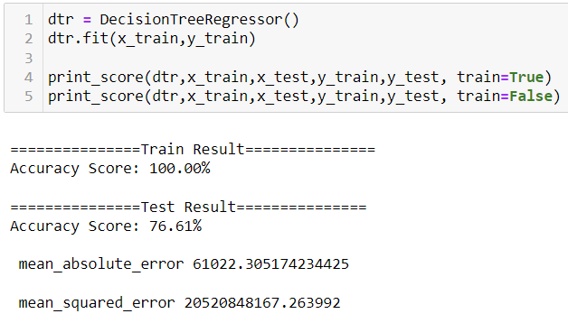
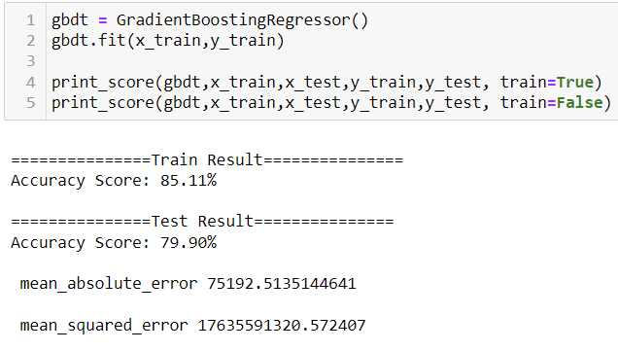
Model Dashboard
1. LinearRegression: -
2. DecisionTreeRegressor: -
3. AdaBoostRegressor: -
4. GradientBoostingRegressor: -

Slide 11
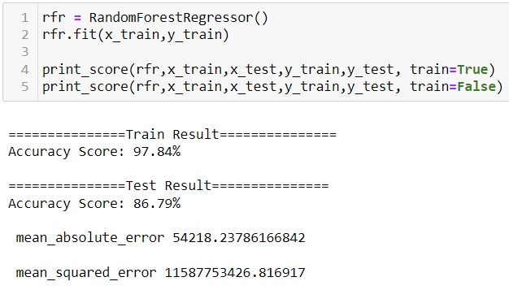
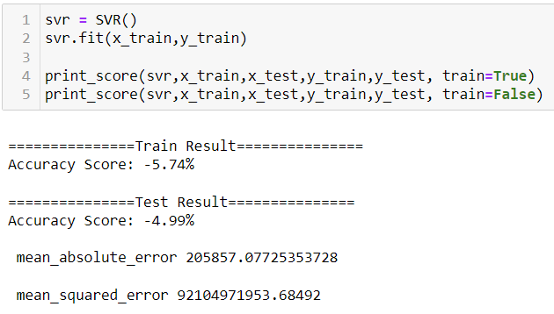
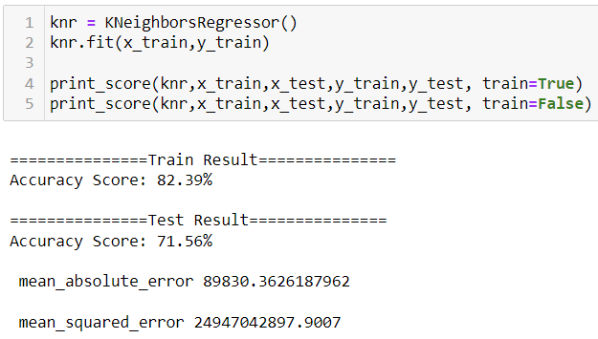
Model Dashboard
5. RandomForestRegressor: -
6. KNeighborsRegressor: -
7. Support Vector Regression: -

Slide 12
Finalized Model
Key Findings and Conclusions of the Model
Selecting LinearRegression model since the Accuracy score i.e., 67.35% and test scores i.e., 67.33 % are greater and close to each other.
mean_absolute_error is also low for LinearRegression model.
LinearRegression model is not overfitted since r2_score of LassoCV and RidgeCV is same and close to test score i.e., 67.32%.

Slide 13
Conclusion
Interpretation of the Results
Below is the list of highly influencing features or variables to predict the price of the car.
1. Launch_Year = It is very important that the car launch year should be latest which leads to high price of the car.
2. Fuel_tank_capacity = High fuel tank capacity leads to high price of car.
3. Max_power = Max power plays an important role in decides the price of the car.
4. Power_Windows = Types of power windows also impacts the price of the car.

Slide 14
Conclusion
Learning Outcomes of the Study in respect of Data Science
Data Cleaning helps to convert unorganized and unstructured data into structured data which will be used to make findings.
Data visualization helps understand and analyse the data.
Model building helps to predict outcomes, in this case LinearRegression model fits perfect for this dataset.
While doing pre-processing the high VIF problem arises as many highly co-related features have high VIF score.

